Slide 1
Chapter 24
ASP.NET 2.0 Web Applications

Slide 2
Objectives
State management
The role of view state, control state, session-level and application-level variables
The role of the Web.config file

Slide 3
Content
The issue of state
ASP.NET state management techniques
Understanding the role of ASP.NET View State
Understanding the Application/Session distinction
The role of the Global.asax file
Working with the Application Cache
Understanding Cookies
Configuring Your ASP.NET Web Application using Web.config
Configuration inheritance

Slide 4
The issue of state
HTTP is a stateless wire protocol
HTTP has no clue how to automatically remember data once the HTTP response has been sent
When the client posts back to the *.aspx file, a new Page object is constructed that will reset any page-level member variables

Slide 5
ASP.NET state management techniques
ASP.NET provides several mechanisms to maintain stateful information in your web applications:
  Make use of ASP.NET view state
  Make use of ASP.NET control state
  Define application-level variables
  Define session-level variables
  Make use of the cache object
  Interact with cookie data

Slide 6
Understanding the role of ASP.NET View State
ASP.NET runtime will automatically embed a hidden form field (named __VIEWSTATE), which will flow between the browser and a specific page
The data assigned to this field is a Base64-encoded string
  contains a set of name/value pairs that represent the values of each GUI widget on the page at hand
Init event handler is the entity in charge of reading the incoming values found within the __VIEWSTATE field to populate the appropriate member variables in the derived class

Slide 7
Understanding the role of ASP.NET View State
Also, just before the outgoing response is emitted back to the requesting browser,
  the __VIEWSTATE data is used to repopulate the form’s widgets
  ensure that the current values of the HTML widgets appear as they did prior to the previous postback.

Slide 8
Understanding the role of ASP.NET View State
View state is most useful when you have a dynamically populated web widget that always needs to be repopulated for each and every postback
As the payload of the HTTP request/response cycle could become quite heavy, you may find faster throughput if disable view state for the page
To disable view state for the page, set value for enableViewState attribute of <%@Page%> directive to false
ASP.NET pages reserve a small part of the __VIEWSTATE string for internal use

Slide 9
Understanding the role of ASP.NET View State
Adding custom View State data
  Can embed custom information within the hidden __VIEWSTATE form field
  The only valid types of values that are placed within the __VIEWSTATE field are strings, integers, Booleans, ArrayLists, Hashtables, or an array of these types
  Custom view state data is
    best suited for user-specific preferences
    not well suited for full-blown user data

Slide 10
Understanding the role of ASP.NET View State
Control state
  Is most helpful if a custom ASP.NET web control must remember data between round-trips
  Will not be disabled if view state is disabled at the page level

Slide 11
Understanding the Application/Session distinction
Application state is maintained by an instance of the HttpApplicationState type
This class enables you to share global information across all users (and all pages)
If one user changes the value of an application-level data point, the change is seen by all others on their next postback.

Slide 12
Understanding the Application/Session distinction
Session state is used to remember information for a specific user
A user’s session state is represented by the HttpSessionState class type
When a new user logs on to an ASP.NET web application, the runtime will automatically assign that user a new session ID
  will expire after 20 minutes of inactivity

Slide 13
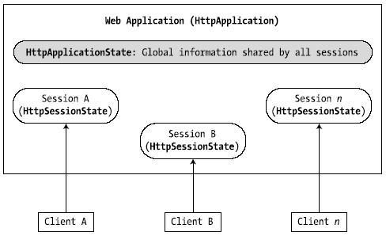
Understanding the Application/Session distinction
The relationship between a web application and web sessions

Slide 14
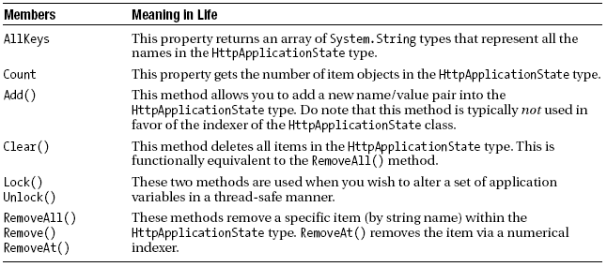
Understanding the Application/Session distinction
Maintaining Application-Level State Data
  The HttpApplicationState type enables developers to share global information across multiple sessions in an ASP.NET application
  Members of the HttpApplicationState type

Slide 15
Understanding the Application/Session distinction
Maintaining Session data
  A session is a given user’s interaction with a web application, which is represented via the HttpSessionState type
  To maintain stateful information for a particular user, the HttpApplication-derived type and any System.Web.UI.Page-derived types may access the Session property

Slide 16
The role of the Global.asax file
Contains event handlers to interact with application-level and session-level events
Application_Start()
  is called the very first time the web application is launched
  is an ideal place to define application-level data used throughout your web application
Application_End()
  is called when the application is shutting down
  will occur when the last user times out or if you manually shut down the application via IIS

Slide 17
The role of the Global.asax file
Session_Start()
  is fired when a new user logs on to your application
  can create any per-user data items
  can be use to change the default 20-minute expiration value
Session_End()
  is fired when a user's session has terminated
  perform any work that may need to do when the user's session has terminated

Slide 18

Working with the Application Cache
The ASP.NET System.Web.Caching.Cache object allows to define an object that is accessible by all users (from all pages) for a fixed amount of time

Slide 19
Understanding Cookies
Cookie is often realized as a text file (or set of files) on the user’s machine
When a user logs on to a given site, the browser checks to see if the user’s machine has a cookie file for the URL in question and, if so, appends this data to the HTTP request
The exact location of your cookie files will depend on browser
The receiving server-side web page could then read the cookie data to create a GUI that may be based on the current user preferences
Cookies are a horrible choice when you wish to maintain sensitive information about the current user (such as a credit card number, password, or whatnot)

Slide 20
Understanding Cookies
ASP.NET cookies can be configured to be either persistent or temporary:
  Persistent cookie is typically regarded as the classic definition of cookie data
    the set of name/value pairs is physically saved to the user’s hard drive
  Temporary cookies (also termed session cookies) contain the same data as a persistent cookie, but they exist only within the HTTP header
    Once the user logs off your site, all data contained within the session cookie is destroyed

Slide 21
Understanding Cookies
Most browsers support cookies of up to 4,096 bytes
  cookies are best used to store small amounts of data
To create a new cookie, access the Response.Cookies property
To interact with the incoming cookie data under ASP.NET, access the HttpRequest.Cookies property

Slide 22
Configuring your ASP.NET Web application using
Web.config
Web.config defines the root-level <configuration> element
Can be used to control how your web application should behave at runtime
The Web.config file can be modified using any text editor

Slide 23
Configuring your ASP.NET Web application using
Web.config
Some of the important sub elements
  <authentication>, is used to define the authentication mode for this web application
  <authorization>, is used to define which users can access which resources on the web server
  <connectionStrings>, is used to hold external connection strings used within this website
  <customErrors>, is used to tell the runtime exactly how to display errors that occur during the functioning of the web application

Slide 24
Configuration inheritance
A web application can be defined as the set of all files contained within a root directory and any optional subdirectories
Each subdirectory may have its own Web.config file!
Allow each subdirectory
  to override the settings of a parent directory
  inherit the settings of the next available Web.config file up the directory structure

Slide 25
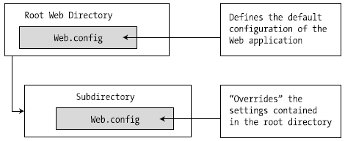
Configuration inheritance
Configuration inheritance
Although ASP.NET allow you to define numerous Web.config files for a single web application, but not required to do

Slide 26
Summary
Examining a number of state management techniques
The distinction of application- and session-level data
Cookie management
The ASP.NET application cache
A number of elements that may be contained in the Web.config file

Slide 27
Q & A

